Slide 1
Customer Insights and Tool Demonstration
Naledi Mosala

Slide 2
Overview
Key Customer Insights
Strategic Recommendations
Tool Demonstration

Slide 3
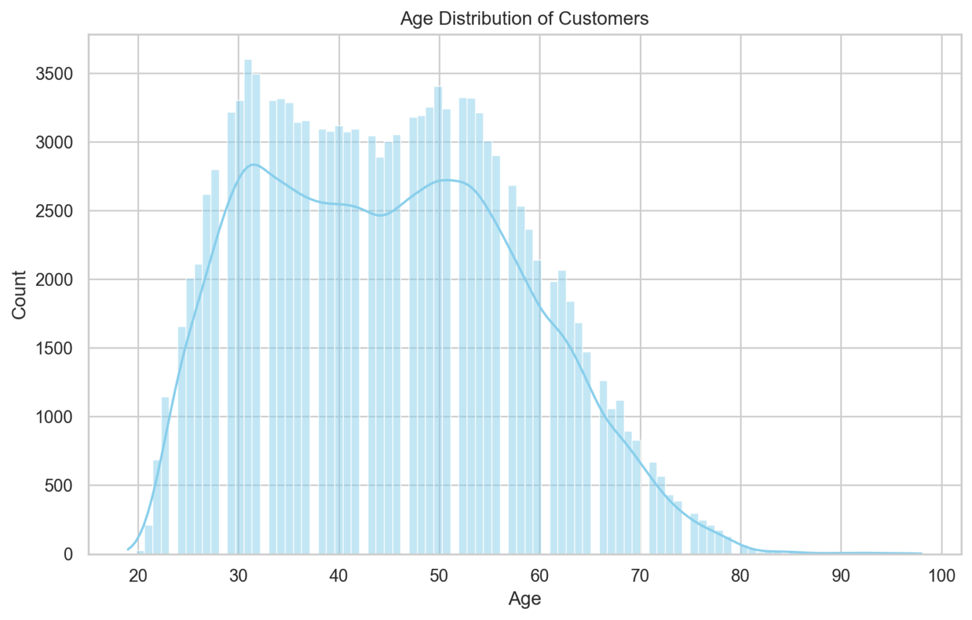
Customer Demographics: Age
Majority of customers between 30–50 years old

Slide 4
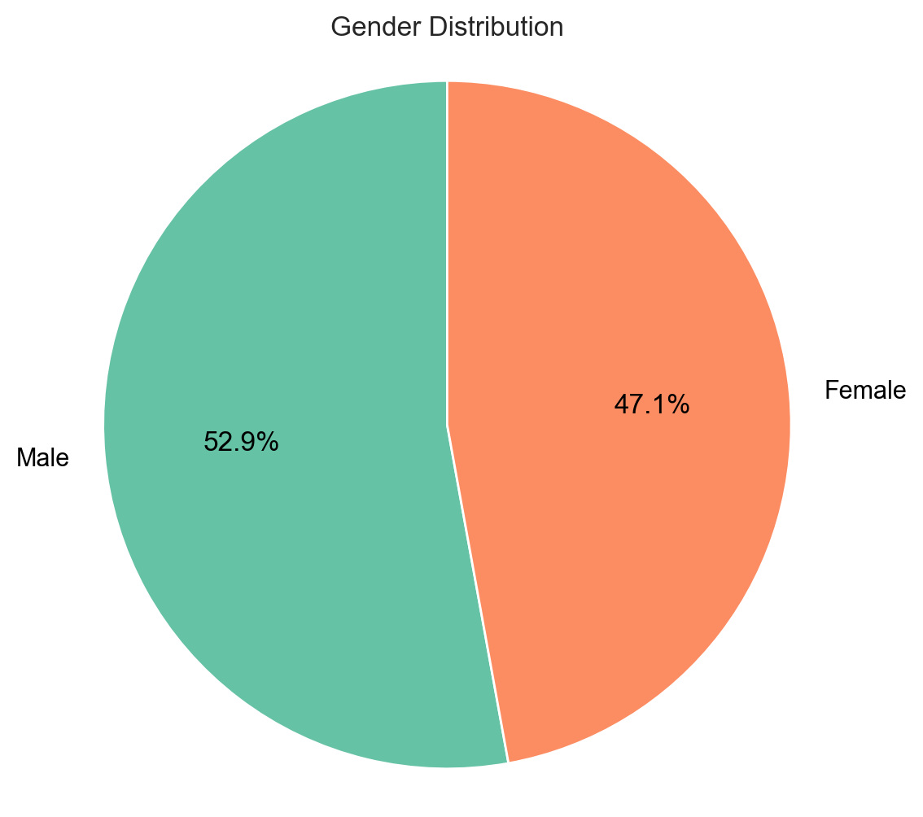


Customer Demographics: Gender
Balanced ratio, 11.6% more men

Slide 5
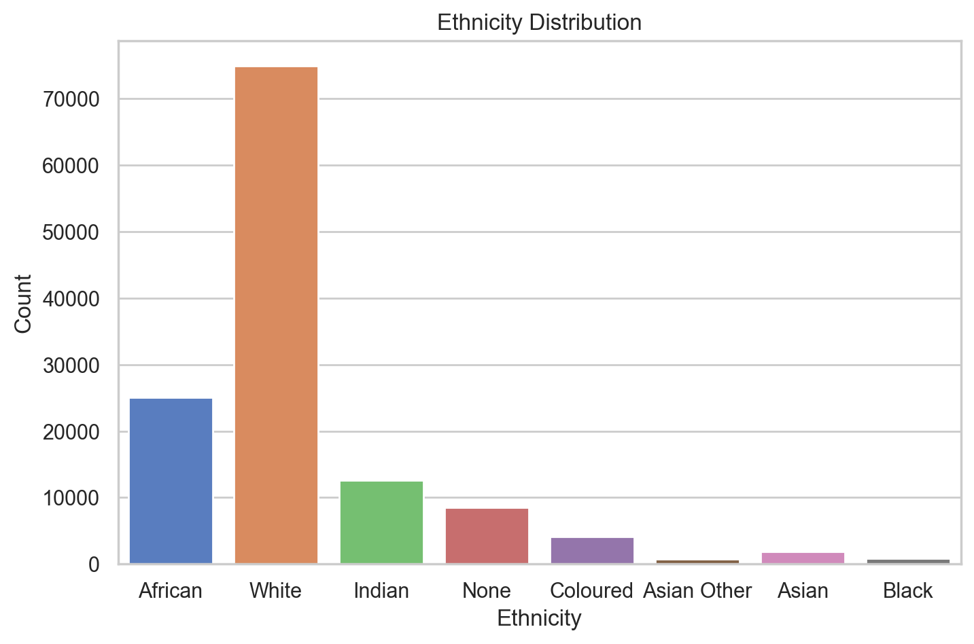
Customer Demographics: Ethnicity
Predominantly White – 37%

Slide 6
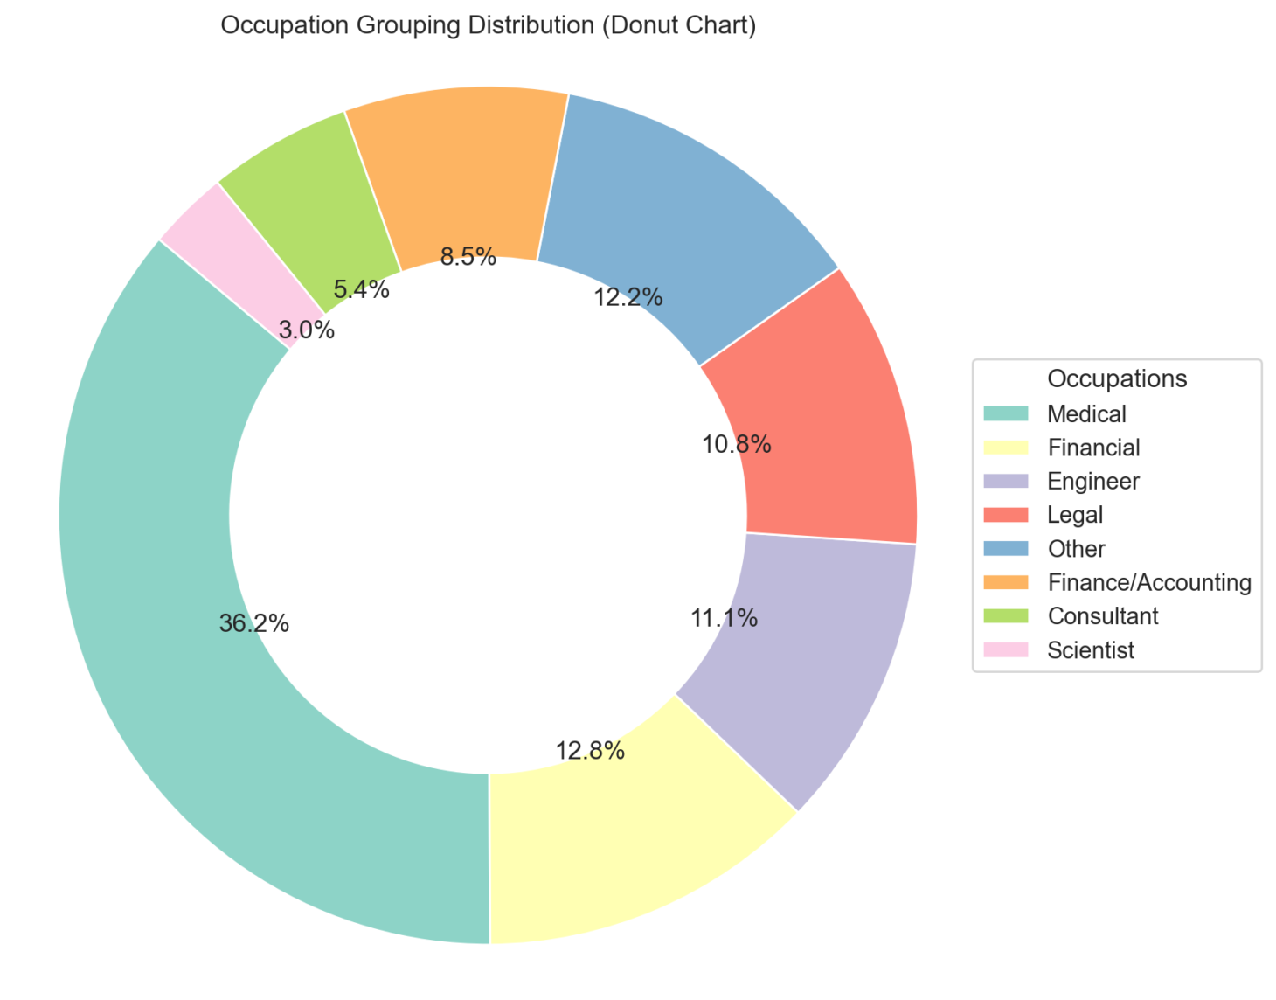
Customer Demographics: Occupation
36.2% of customers work in the medical sector

Slide 7

Product Ownership Trends
Key Insights:
INSCO and STI are owned by 100% of customers
Medical professionals have the highest product overlap
Science/Research professionals: 75% enrolled in PPSI

Slide 8

Income Behaviour by Age
Key Insight:
Customers aged 46–60 are the highest earners, across both genders

Slide 9
Strategic Recommendations
Bundle Premium Products for high-income professionals (e.g., PPSI + PROFMED + STI)
1
Upsell to Medical Professionals, who currently hold only 2 products
3
Cross-Sell to Younger Customers with affordable starter options (e.g.,ProfMed or PPSI via email/app)
2

Slide 10

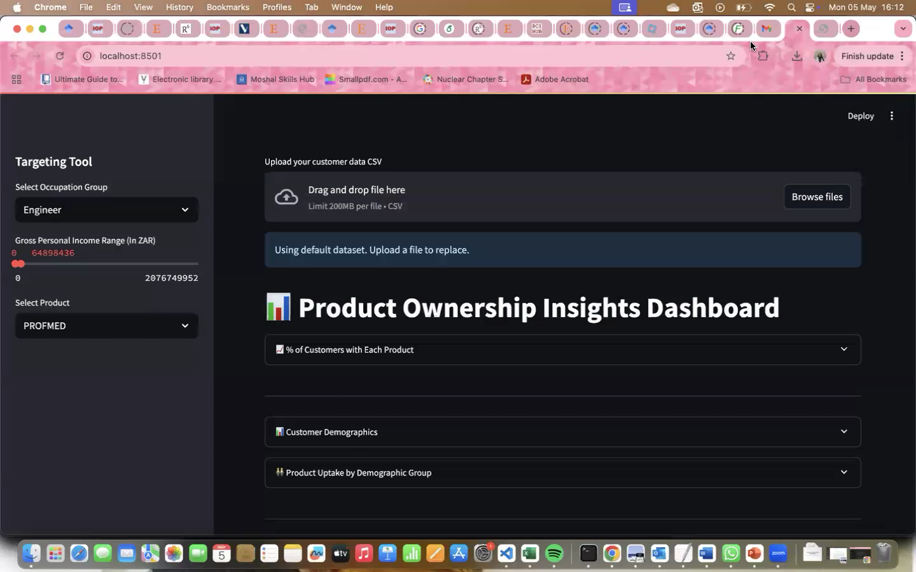
Tool Demonstration

